Slide 1

Gerardo Chowell, PhD Professor of Epidemiology and Biostatistics SISMID 2024
Introduction to Mathematical Epidemiology

Slide 2
Mathematical Models
From toy models to high-fidelity models..
Homogeneous mixing
Minimum number of disease stages
No social/demography structure
Very high degree of heterogeneity
Large number of disease stages
Sophisticated social network
COMPLEXITY

Slide 3
Why Use Mathematical Models to Study Disease Spread?

Slide 4
Mathematical models provide a consistent framework for analysis, prediction, understanding, and providing feasible forecasts for:
Predicting the emergence of new pathogens
Estimating the degree to which the disease will spread among different populations
Understanding of the early history of an outbreak and identifying the initial infection
Optimizing the impact of prevention strategies on disease transmission;
Assessing the impact of proposed medical interventions
Improving our understanding of the interaction of risk factors as they affect transmission (example: schools, and work environment); and
Assessing the effectiveness of partial protection to infection by vaccination or protective clothing.

Slide 5
Possible Research Topics
Investigate epidemiology and transmission parameters
Evaluate the contribution of different transmission mechanisms (asymptomatic vs symptomatic transmission)
Optimal allocation of social distancing and pharmaceutical interventions (vaccines, therapeutics)
Forecast the course of the epidemic in terms of cases, hospitalizations, deaths, etc.

Slide 6
Complexities of epidemics

Slide 7
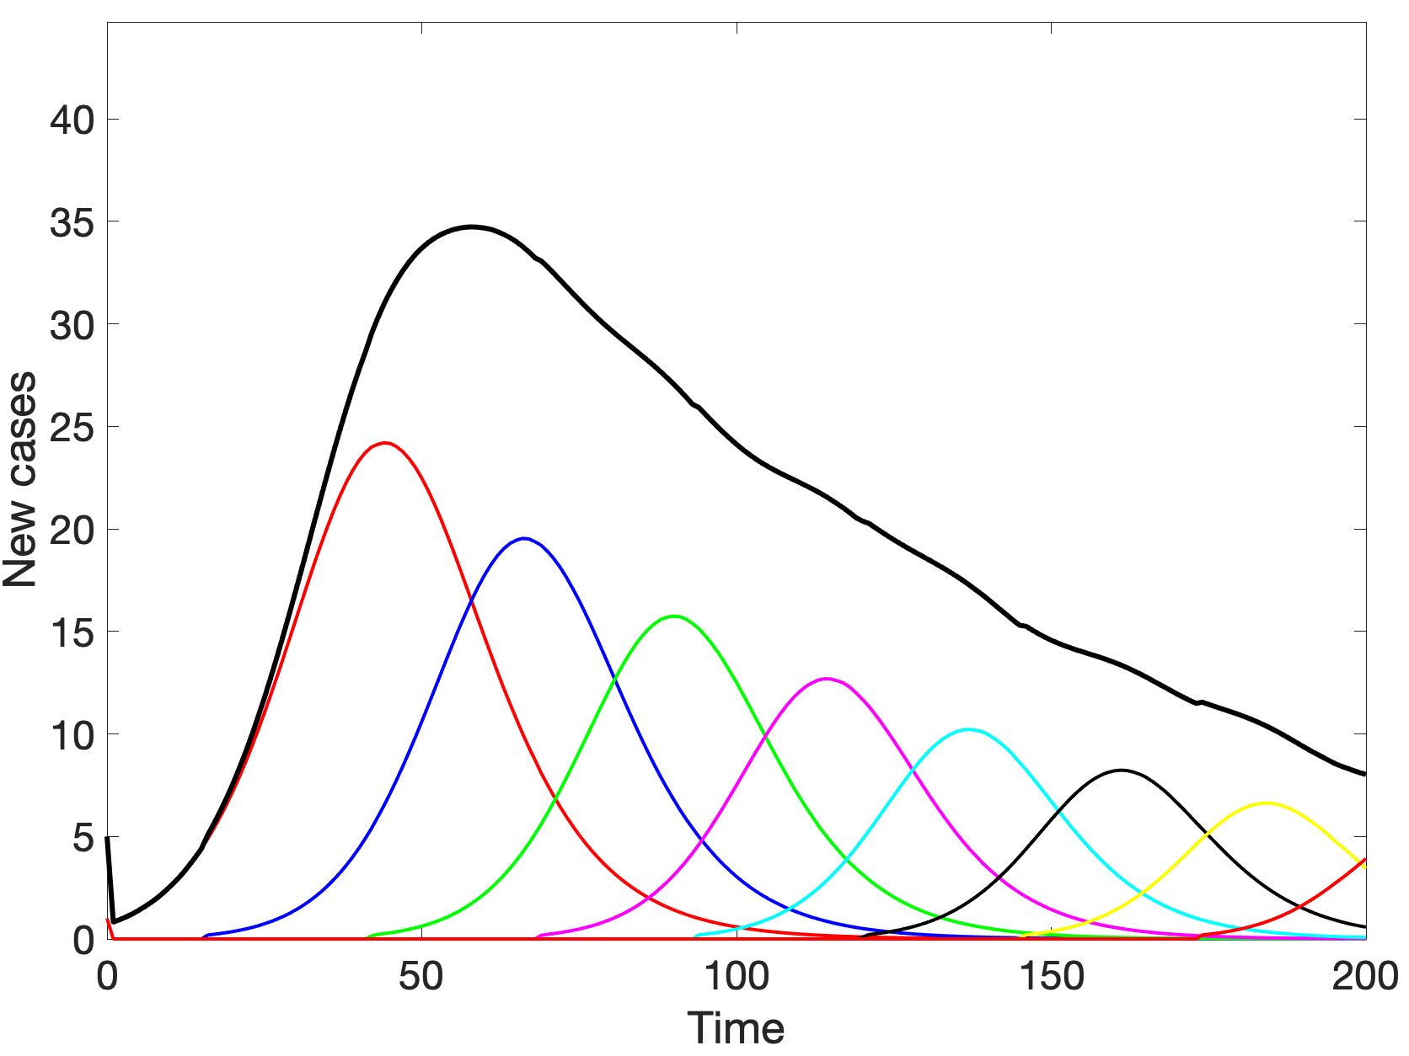
The complexity of epidemics: Sub-Epidemics
Epidemics are usually presented as single event (i.e., Aggregated epidemic), however they often consist of multiple interacting, overlapping “sub-epidemics”
Sub-epidemic
Aggregated epidemic
Sub-Epidemic
Outbreaks with unique characteristics (i.e., transmission rates, affected populations, responses to interventions) underlying an epidemic

Slide 8
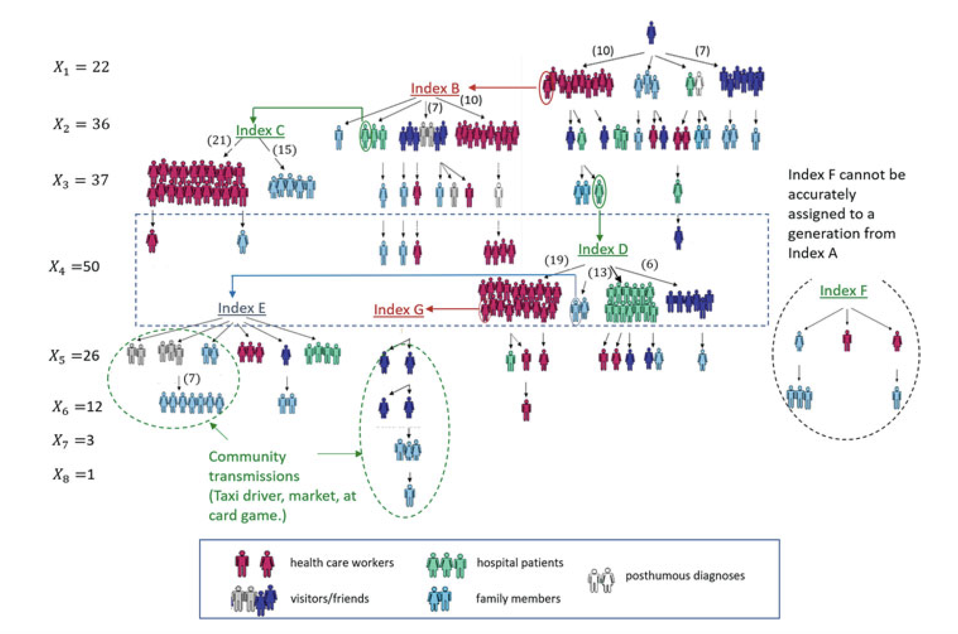
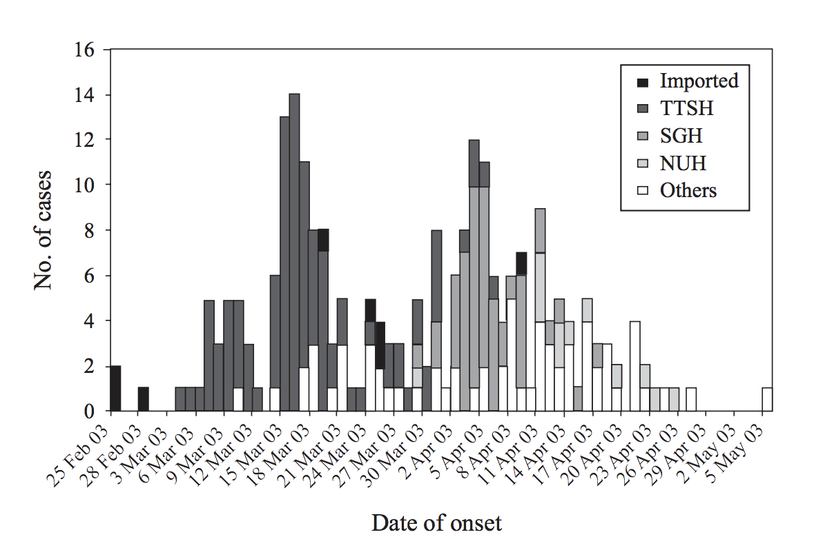
Example: The complexity of epidemics
Adapted from Goh et al. 2006

Slide 9
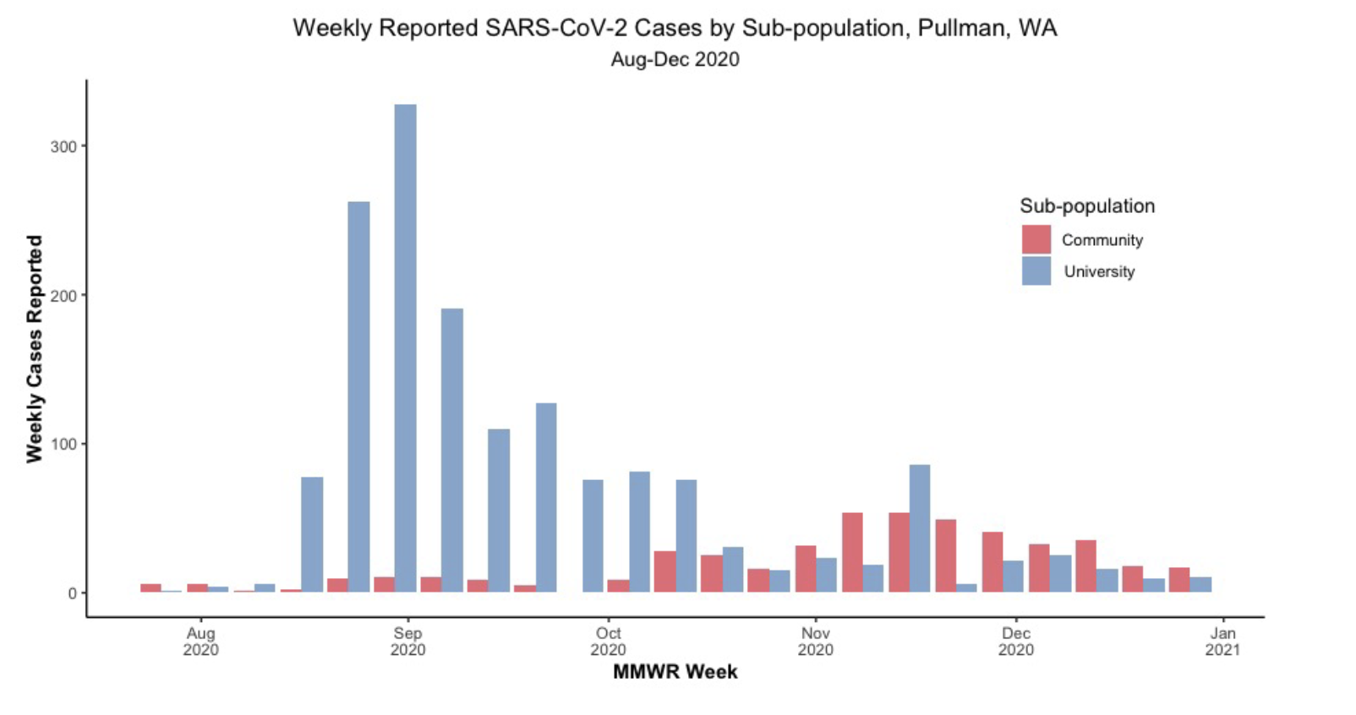
Example: The complexity of epidemics
Mietchen et al. medrxiv (2024)

Slide 10
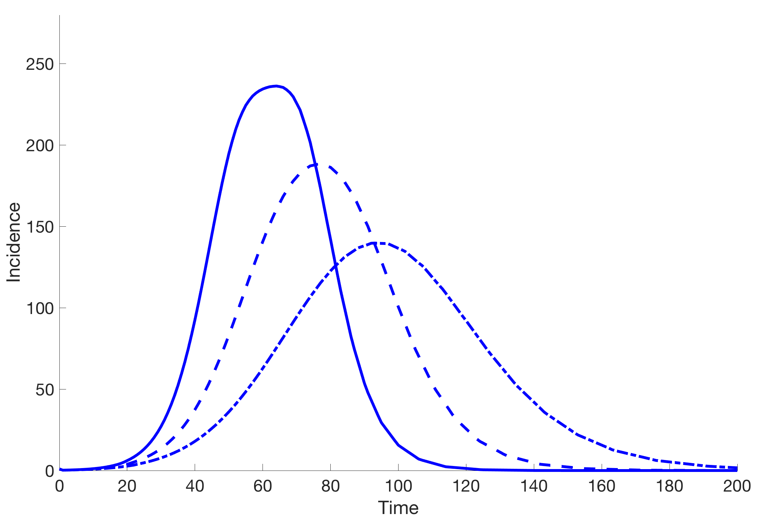
The complexity of epidemics: Variable epidemic growth scaling
Increasing Saturation effects
Possible reasons for different epidemic growth scaling:
Mode of transmission
Reactive behavior changes
Spatial effects (clustering)
Other individual-level heterogeneities in susceptibility and infectivity
Viboud et al. Epidemics (2016); Chowell et al. JR Interface (2016)

Slide 11
Exponential vs. sub-exponential epidemic growth: Implications for epidemic modeling

Slide 12
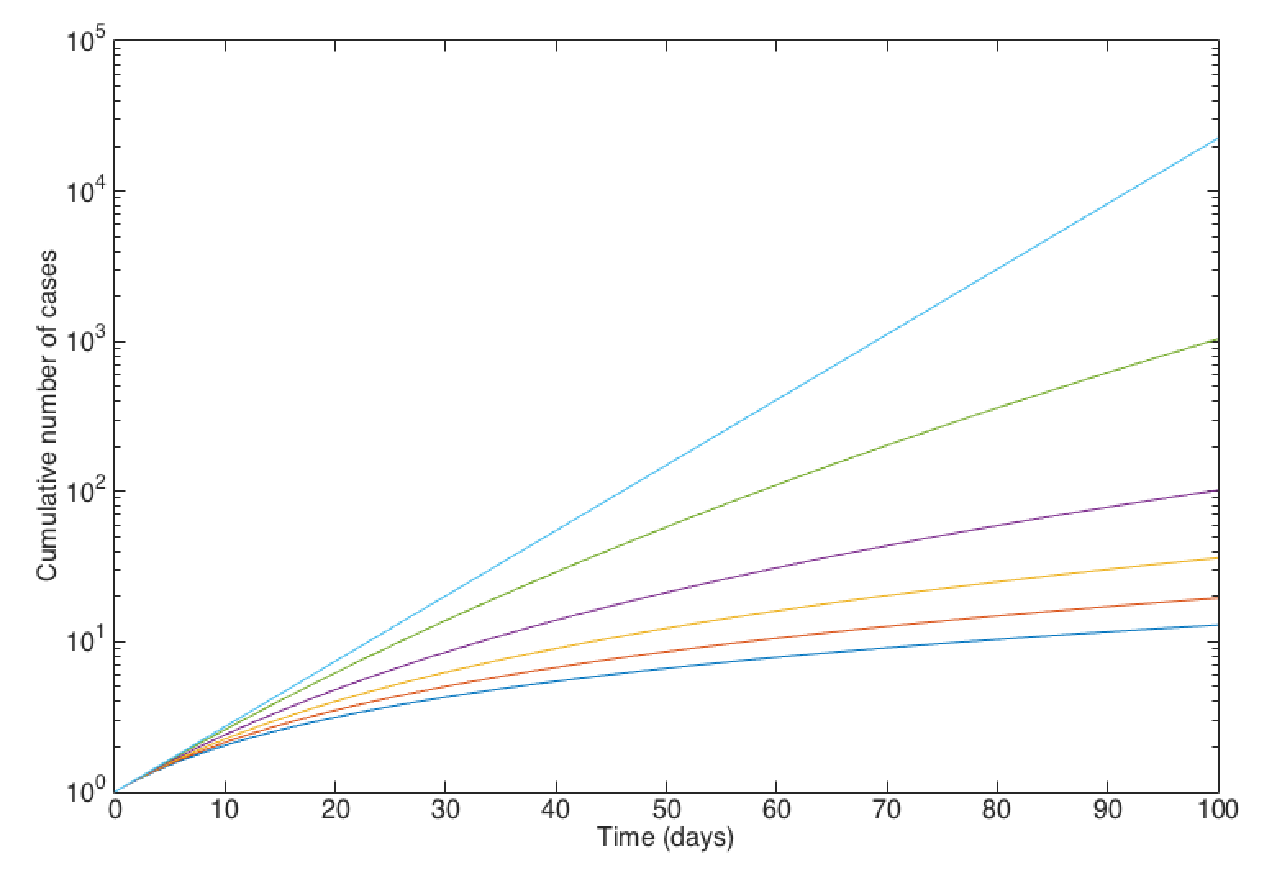
Common assumption made in epidemic models (homogenous mixing)
Exponential
Sub-exponential

Slide 13
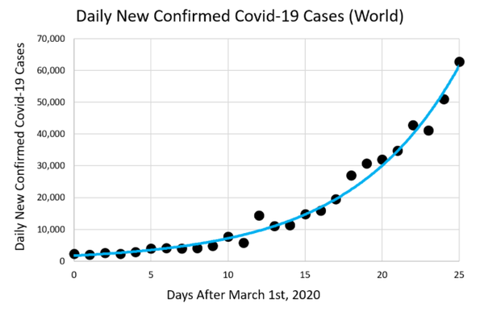
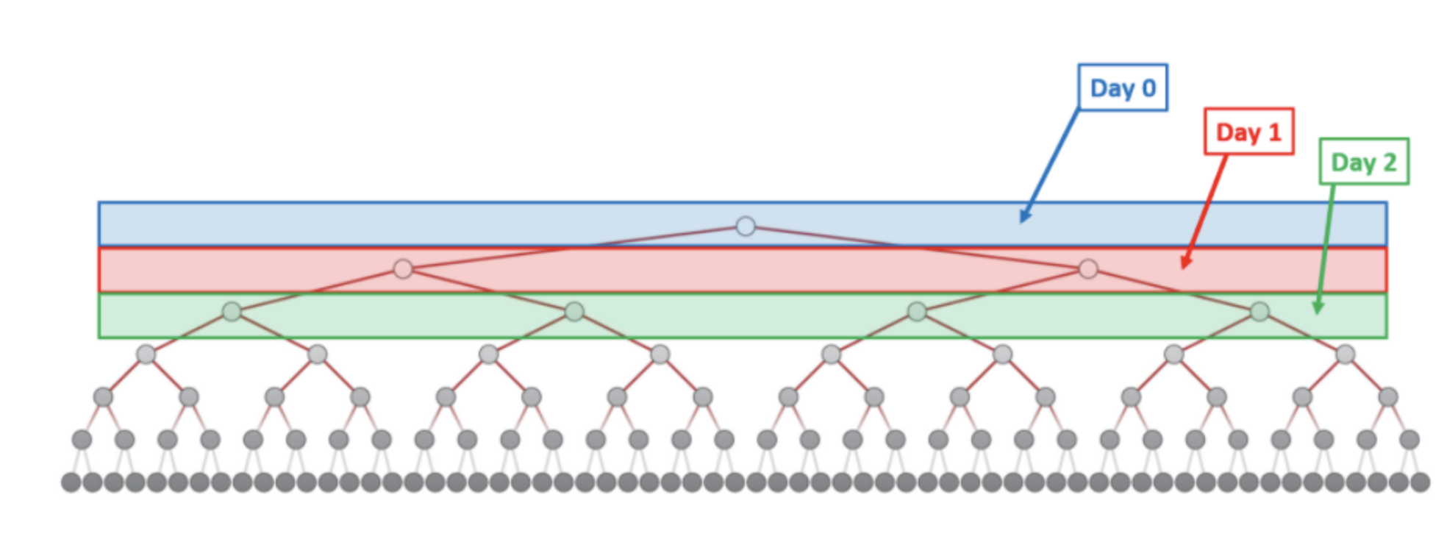
Example: SARS-CoV-2 Pandemic
The Math of Ending the Pandemic: Exponential Growth and Decay. The New York Times. By Dashiell Young-Saver 2021.

Slide 14
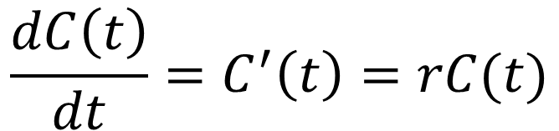
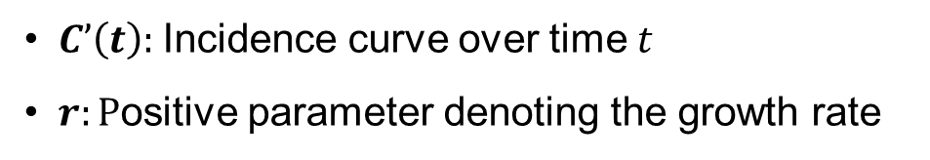
Exponential growth (EXP)
$$\frac{dC\left(t\right)}{dt}=C^{′}\left(t\right)=rC(t)$$
$C’\left(t\right):$Incidence curve over time $t$
$r:P$ositive parameter denoting the growth rate

Slide 15
Exponential growth curves

Slide 16
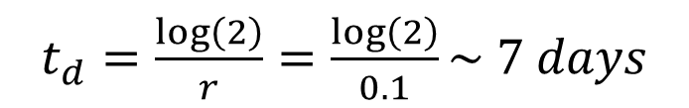
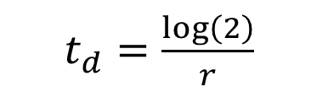
Doubling Time
Definition
The time it takes for the number of cases to double.
If the epidemic is growing exponentially fast, the doubling time ($t_{d}$) is given by:
$t_{d}=\frac{\log\left(2\right)}{r}$
Example: Given a growth rate of $r=0.1$ per day, what is the doubling time?
$t_{d}=\frac{\log\left(2\right)}{r}=\frac{\log\left(2\right)}{0.1}\sim 7 days$
We conclude that the epidemic doubles in size approximately every 7 days during the exponential growth phase.

Slide 17
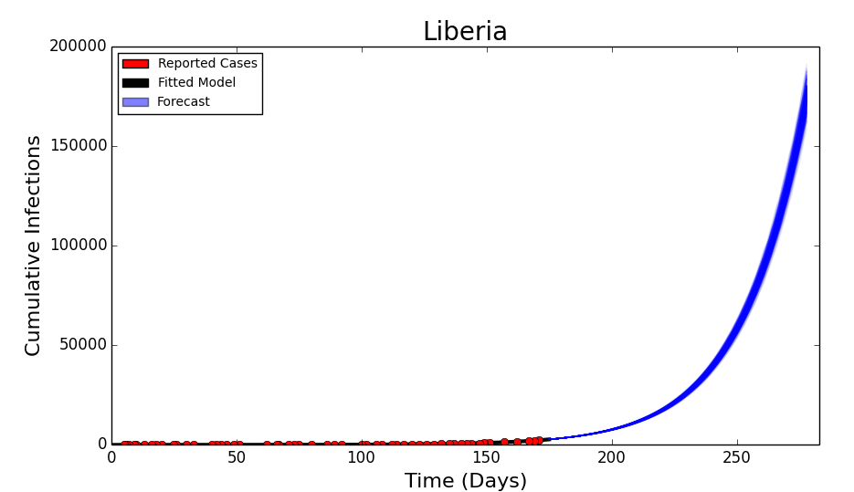
Example: “Worst-case” Scenarios
No changes in behavior or increased medical interventions.
Calibration
Forecast
Exponential growth

Slide 18
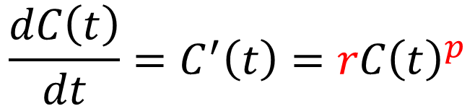
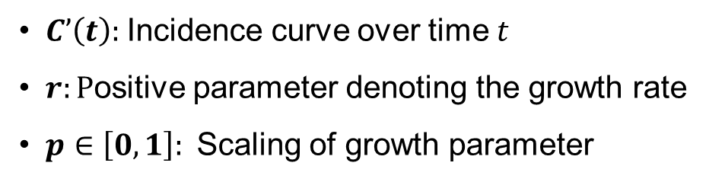
Generalized growth model (GGM)
$$\frac{dC\left(t\right)}{dt}=C^{′}\left(t\right)=rC{\left(t\right)}^{p}$$
$C’\left(t\right):$Incidence curve over time $t$
$r:P$ositive parameter denoting the growth rate
$p∈\left[0,1\right]:$Scaling of growth parameter
Chowell & Viboud. Infectious Disease Modeling (2016); Viboud, Simonsen, Chowell. Epidemics (2016)

Slide 19
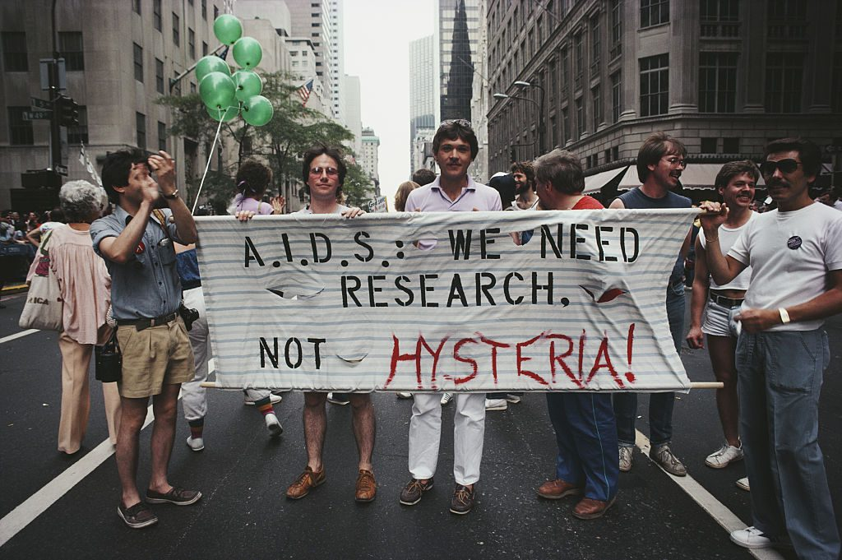
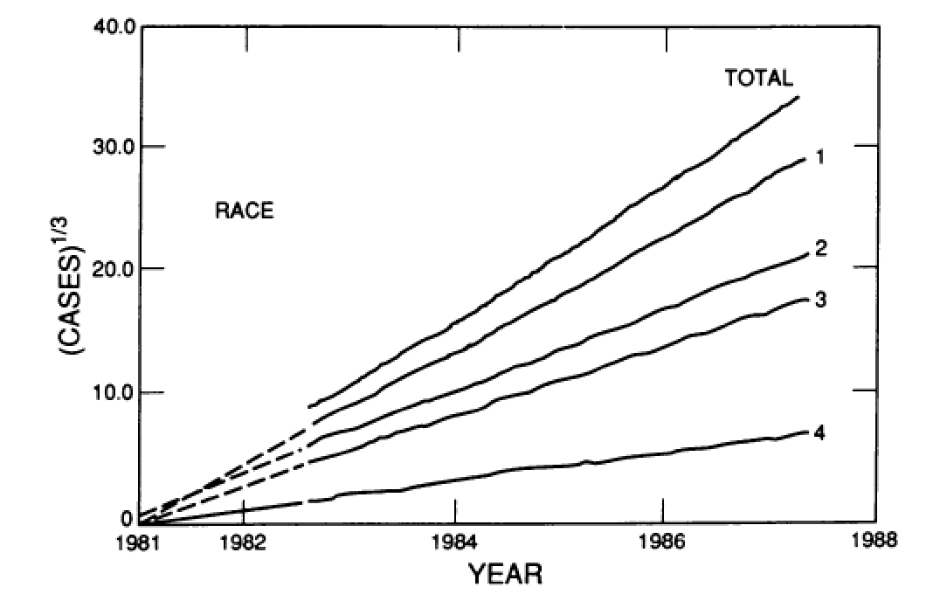
Example: The initial phase of the HIV/AIDS epidemic
in the United States
1 = White
2 = Black
3 = Hispanic
4 = Unknown
https://www.pbs.org/newshour/science/america-hiv-outbreak-origins-nyc-gaetan-dugas
Colgate et al. PNAS (1989)

Slide 20
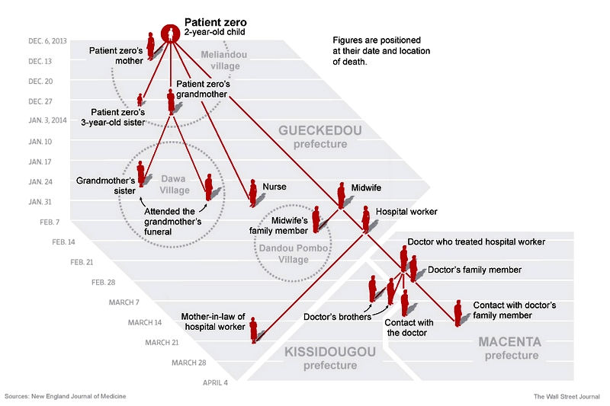
Example: Early Ebola transmission tree

Slide 21
Example: Exponential vs. sub-exponential growth

Slide 22
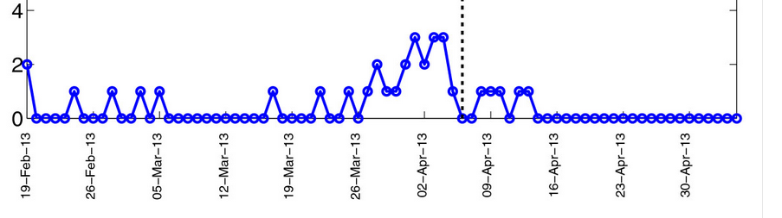
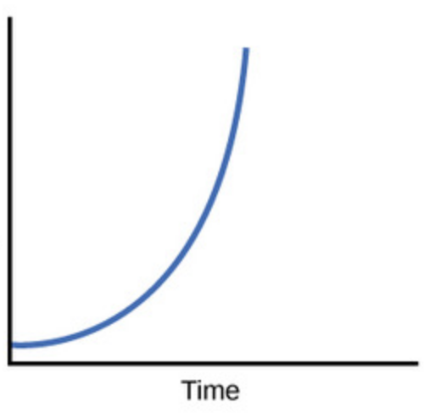

The basic reproduction number, $R_{0}$
Definition
The number of secondary cases generated by a primary infectious case during its period of infectiousness in an entirely susceptible population. It is an important indicator to guide intervention strategies (i.e., higher R₀ mean stronger interventions required).
Stuttering chains (subcritical), R₀<1
Epidemics (supercritical), R₀>1
Case incidence
Exponential growth
Time

Slide 23
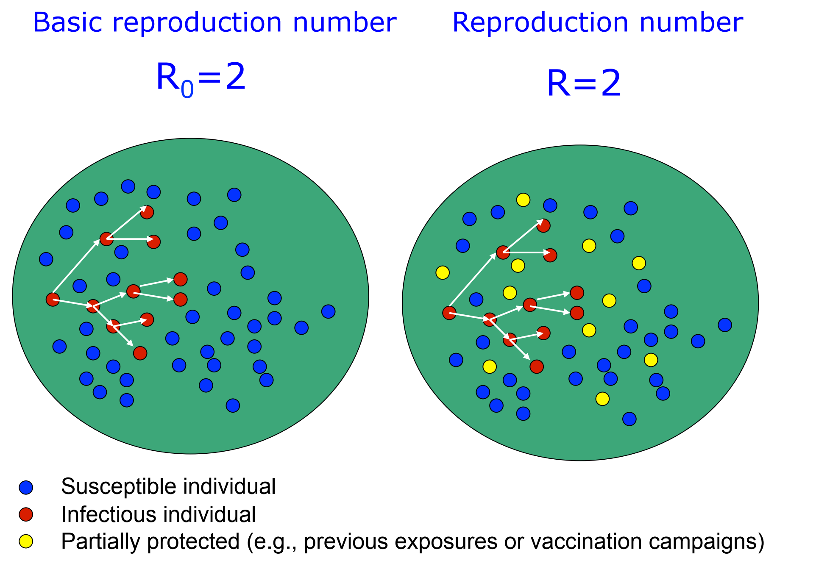
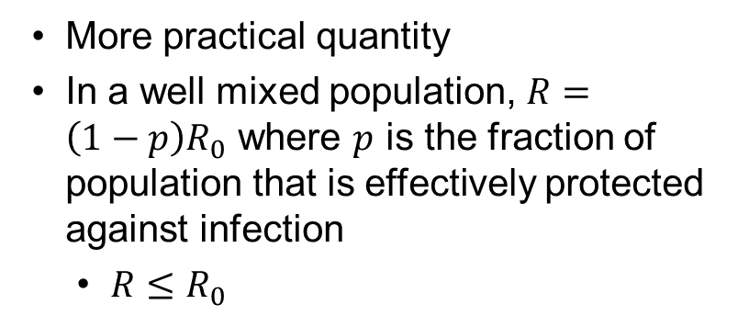
Reproduction numbers
Measures transmissibility in a partially immune population because of previous exposures to infectious disease agents or vaccination campaigns.
More practical quantity
In a well mixed population, $R=\left(1−p\right)R_{0}$ where $p$ is the fraction of population that is effectively protected against infection
$R≤R_{0}$

Slide 24
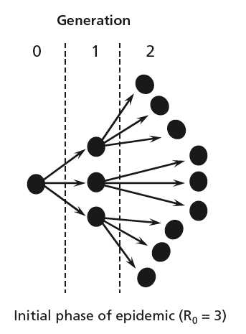
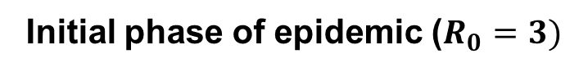
Generation Time
The time between the infection of a primary case and one of its secondary cases.
Generation
Infectious individuals
Initial phase of epidemic ($R_{0}=3)$

Slide 25
Common Epidemic models
Epidemic models can help us characterize an epidemic process including:
Identify the relevant epidemiological states of the individuals and other actors (e.g., mosquitoes, rats) involved in the transmission dynamics of infection.
Devise equations that describe transmission mechanisms (e.g., close contact, sexual contact, airborne transmission, indirect transmission).
Evaluate the impact of different mitigation strategies.
Sir Ronald Ross

Slide 26

What is NOT needed:
A black box

Slide 27
Model Building Blocks: Differential Equations

Slide 28
What is a differential equation?

Slide 29
A differential equation describes the state of a variable as a function of time
$$\frac{dx}{dt}=Rate of Change in x=Inflow rate\left(t\right)−Outflow rate(t)$$

Slide 30
Initial state / initial conditions

Slide 31
Example: One differential equation with constant rates of inflow and outflow (quantity grows)

Slide 32
Example: One differential equation with constant rates of inflow and outflow (quantity declines)

Slide 33
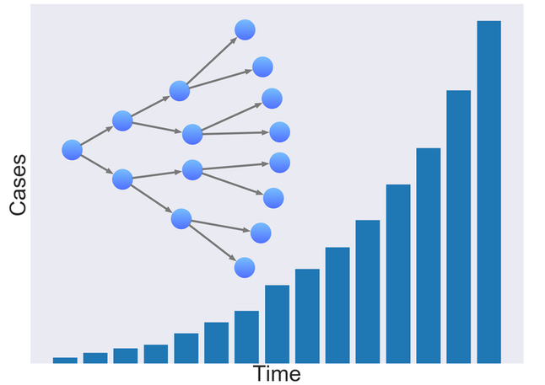
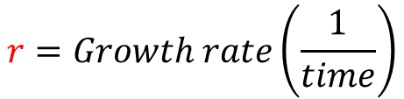
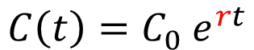
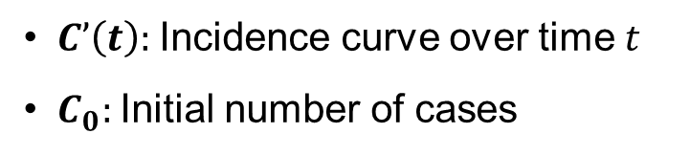
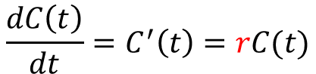
Example: Exponential Growth
$$C\left(t\right)=C_{0} e^{rt}$$
Differential Equation
$$\frac{dC\left(t\right)}{dt}=C^{′}\left(t\right)=rC(t)$$
$$r=Growth rate\left(\frac{1}{time}\right)$$
$C’\left(t\right):$Incidence curve over time $t$
$C_{0}:$ Initial number of cases

Slide 34
Model Types: Deterministic vs. Stochastic

Slide 35
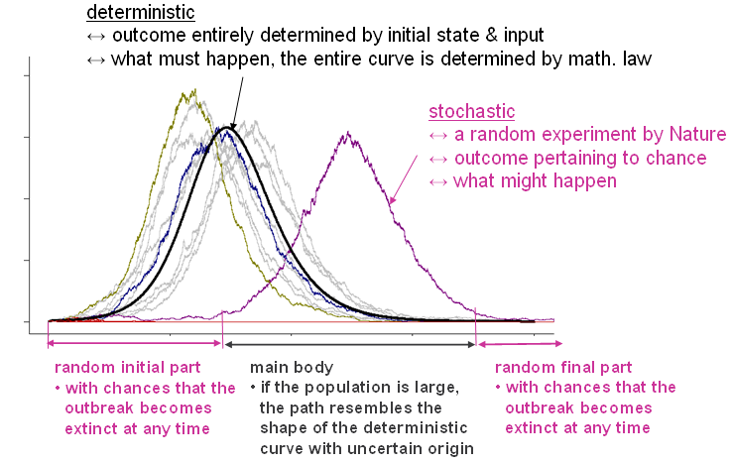
Deterministic vs. stochastic models
Deterministic models produce the same exact results for a particular set of parameters and initial conditions.
Rely on the average rates of the process
Applicable to large populations
Stochastic models account for certain levels of unpredictability or randomness.
More appropriate to deal with small populations
Each realization of the stochastic model is different

Slide 36
Example Model 1: Susceptible-Infectious-Recovered (SIR)

Slide 37
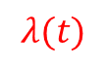
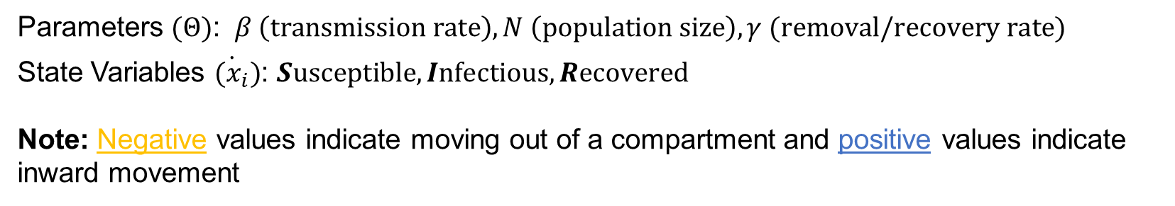

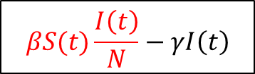

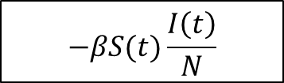
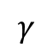
A simple epidemic model (SIR)
N
$$−βS(t)\frac{I\left(t\right)}{N}$$
$$λ(t)$$
$$βS(t)\frac{I\left(t\right)}{N}−γI\left(t\right)$$
$$γ$$
$$γI\left(t\right)$$
$$N=S+I+R$$
Parameters $(Θ)$: $β \left(transmission rate\right), N \left(population size\right), γ (removal/recovery rate)$
State Variables $\dot{{(x}_{i}})$: $Susceptible, Infectious,Recovered$
Note: Negative values indicate moving out of a compartment and positive values indicate inward movement

Slide 38
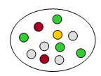
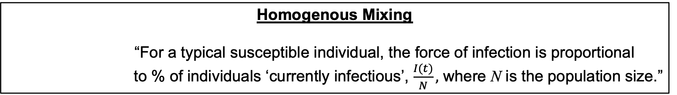
Assumptions: SIR model (Deterministic)
“Keep things simple, but not simpler.” -- Einstein
Homogenous Mixing
“For a typical susceptible individual, the force of infection is proportional
to % of individuals ‘currently infectious’, $\frac{I(t)}{N},$ where N is the population size.”
Complete Susceptibility
The entire population is equally susceptible to the infectious agent.
Timing of Infection
Individuals become infectious instantaneously after exposure to the infectious agent.
Notes:
38

Slide 39
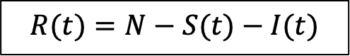
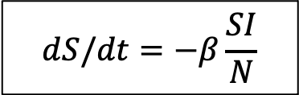
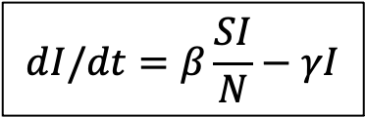
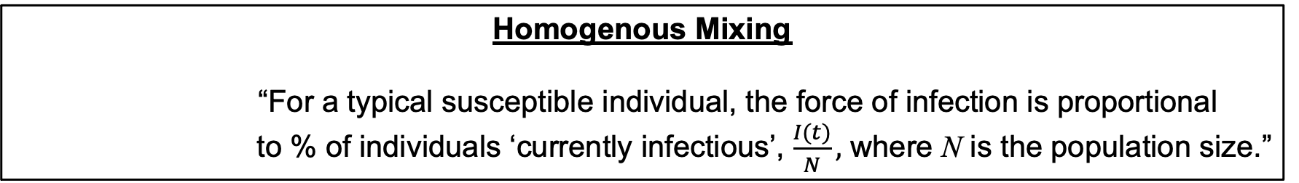
SIR model (Deterministic)
“Keep things simple, but not simpler.” -- Einstein
Homogenous Mixing
“For a typical susceptible individual, the force of infection is proportional
to % of individuals ‘currently infectious’, $\frac{I(t)}{N},$ where N is the population size.”
Incident cases at time t = Incidence rate ($\frac{βI\left(t\right)}{N}$) X Susceptible population (S(t))
Change of prevalence:
$$dI/dt=β\frac{SI}{N}−γI$$
Assuming constant n, at time t
$$R(t)=N−S(t)−I(t)$$
$$dS/dt=−β\frac{SI}{N}$$
Depletion of susceptible:
individuals recovered with immunity.
Notes:
39

Slide 40
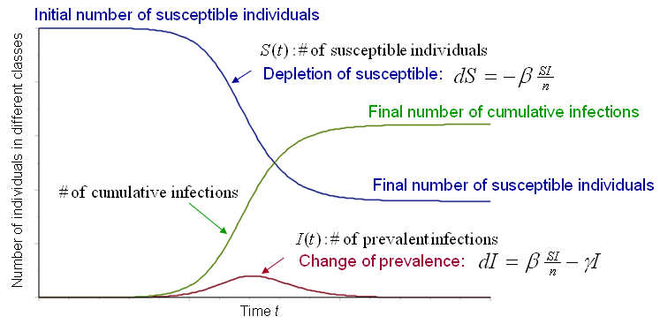
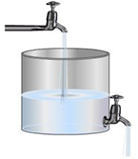
SIR model (Deterministic)
“Keep things simple, but not simpler.” -- Einstein
Implicitly implied:
Population size is constant

Slide 41
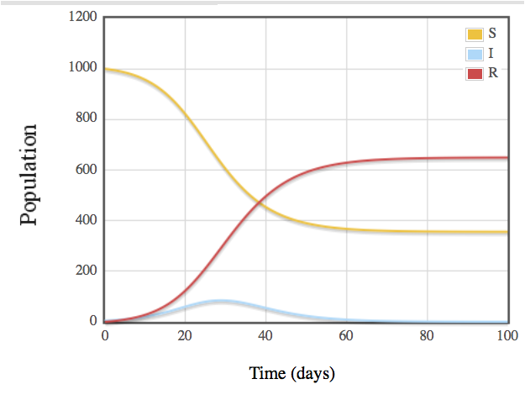
Example: SIR mathematical model results
Population size:1000
Transmission rate: 0.4
Infectious period: 4 days
5 individuals initially infectious

Slide 42
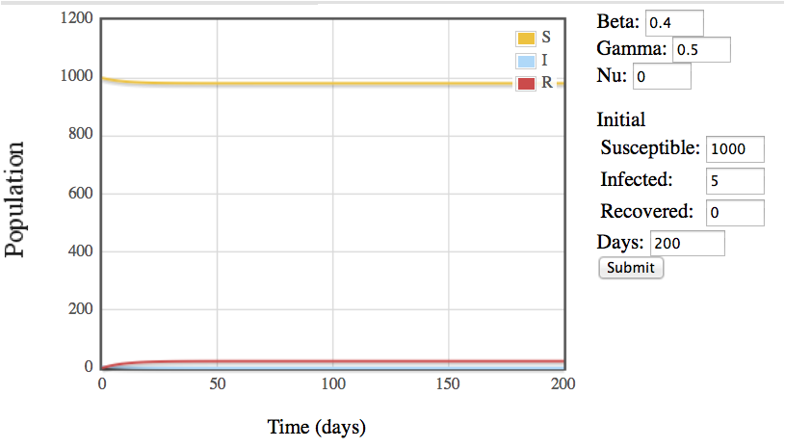
Example: SIR model (2-day infectious period)
Population size: 1000
Transmission rate: 0.4
Infectious period: 2 days
5 individuals initially infectious

Slide 43
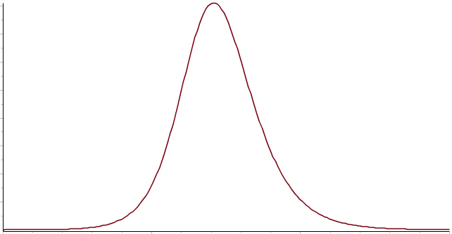
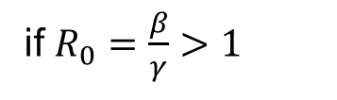
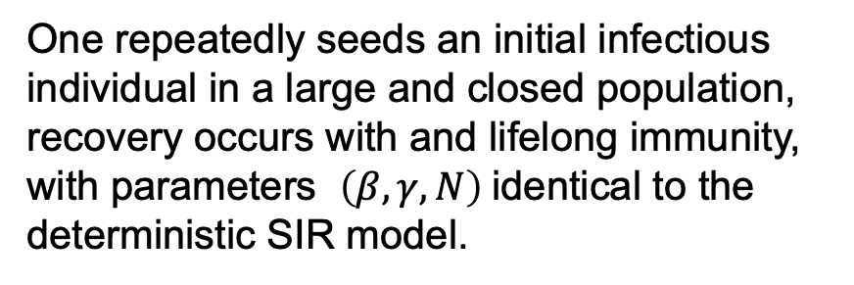
Deterministic vs. Stochastic SIR Model
Per the previous deterministic SIR model:
if $R_{0}=\frac{β}{γ}>1$
This must happen.
Computer simulated scenarios (Stochastic)
One repeatedly seeds an initial infectious individual in a large and closed population, recovery occurs with and lifelong immunity, with parameters $\left(β,γ,N\right)$identical to the deterministic SIR model.
In many tries, there is no outbreak except for a very few initial transmissions. So, an outbreak is not longer a “must happen” situation no matter how contagious is the disease.

Slide 45
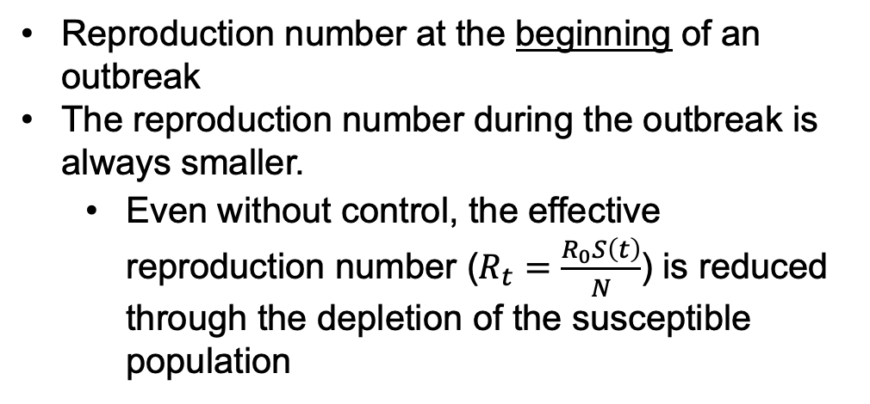
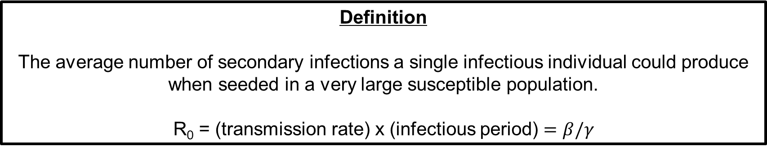
Basic Reproduction Number ($R_{0}$) for Deterministic SIR
Definition
The average number of secondary infections a single infectious individual could produce when seeded in a very large susceptible population.
R₀ = (transmission rate) x (infectious period) $=β/γ$
Reproduction number at the beginning of an outbreak
The reproduction number during the outbreak is always smaller.
Even without control, the effective reproduction number ($R_{t}=\frac{R_{0}S\left(t\right)}{N}$) is reduced through the depletion of the susceptible population
Example
For a disease like influenza, the mean infectious period is about 4 days and the mean transmission rate is about 0.4 new infections per day per infected person. Hence,
R₀ = 0.4 X 4 = 1.6
General conclusion: An outbreak is possible if $R_{0}>1.$

Slide 46



R₀ and final epidemic size (Deterministic SIR)
General conclusion: There is always a proportion “susceptibles” that escape infection (i.e. the final % of infected < 100%), and this proportion is predicted by R₀ before the outbreak.
Final size formula:
$$z=1−exp⁡(−Ro∗z)$$

Slide 47

R₀ and final epidemic size (Deterministic SIR)
$R_{0}=β/γ$ is essential. Different values of $β$ and $γ$ only affect the
time-course towards the final outcome.
R₀ = 3.0: 20% reduction of R₀
6% reduction of the final proportion of
infected
R₀ = 1.5: 20% reduction of R₀
27% reduction of the final proportion of
infected
Vaccination coverage: Assume a vaccine is available and is less than perfect with effectiveness $Φ≤1,$ define a quantity $V_{c}=\frac{R_{0}−1}{R_{0}Φ}.$If vaccine coverage is $≥V_{c}$, the reproduction number is controlled to $<1$. We say then can say that the whole population has “herd immunity”. (If $Φ$ is too small, then $V_{c}≥1.$ Herd immunity is not achievable).

Slide 48


Impact of interventions
General conclusion: The prevalence of infected but not yet recovered individuals, $I\left(t\right),$peaks when the effective reproduction number $R_{t}=\frac{R_{0}S\left(t\right)}{N}$is reduced to cross $R_{t}=1.$
No Interventions
How interventions change the course of the outbreak

Slide 49
Impact of interventions
Qualitatively speaking, if a public health prevention action (e.g., vaccination) started early, it will:
Slow down the initial growth of the “epidemic curve”, because of the further reduction of the effective reproduction number $R_{t}$
Slow down the initial growth of the “epidemic curve”, because of the further reduction of the effective reproduction number 𝑅_𝑡
Reduce the peak level of the “epidemic curve” and the final number of totally infected
Delay the peak time of the outbreak or epidemic.

Slide 50

Timing of interventions is key
“Keep things simple, but not simpler.” -- Einstein
General conclusion: The timing of interventions can change the course of the outbreak

Slide 51
Timing of interventions is key
Qualitatively speaking,
Early intervention (i.e. before the “exponential growth” of an outbreak) may avoid or minimize the outbreak: Does successful intervention mean “shooting at own foot”?
If the outbreak is avoided, are we “crying wolves”? (as well as lawsuits for adverse effects …)
If not avoided but minimized, how do we prove that intervention was effective? Without comparison with the worse scenario (curve 1), what happened (curve 2) looks as if there is a bell-shaped epi-curve anyway !
Once exponential growth has been observed in the data (i.e., with delays in reporting etc.) the effectiveness of prevention is minimal … but …

Slide 52




Conclusions hold in more complex (deterministic) SIR-type models
$$dI/dt=β\frac{SI}{N}−γI$$
Assuming a constant n, at time t, there are
$$dS/dt=−β\frac{SI}{N}$$
$$R(t)=N−S(t)−I(t)$$
individuals recovered with immunity.
seems over-simplified. But the conclusions shown in previous slides are general, and also true in:
more complicated models such as incorporating a latent (infected but not infectious) period
recovery rate not constant (thus not a simple $γ$as a parameter),
large populations regardless the population size,
different time scales,
and to some extent, some non-homogeneous mixing patterns.

Slide 53
Conclusions hold in more complex (deterministic) SIR-type models
In the more complicated models, $R_{0}$may be not expressed as $\frac{β}{γ}$ but as long as keeping the definition as
“the expected number of secondary infections generated by a typical infectious individual during its entire infectious period, if seeded in a large population at the beginning”,
then the general conclusions hold:
and the calculation of vaccination coverage.

Slide 54




What does the stochastic SIR model say about the final size?
A hypothetical susceptible population of size n = 200 (imagine a very large class, amphitheater, of students)
Final sizes (Frequency)
Out of 500 experiments,
189 times with final size = 1
The largest final size = 180
500 repeated experiments under identical initial conditions, seeding one infected individual, $R_{0}=1.8$
Final size of the outbreaks: between 1 and 200
Final Size = 1: No transmission beside the seed itself
Final size = 200: The entire population is infected
Stochastic simulation
Deterministic SIR
In approximately 56% of the repeated experiments, the final size accounts for a few cases (e.g. < 10).
Otherwise, it might happen that large outbreak occurs and should it happen, the final size is distributed around 146.5.
$R_{0}=1.8$ and Final % Infected $=73.2\%$
$n = 200$, expect 146.5 as final number of infections and this must happen.
Notes:
54

Slide 55




What does the stochastic SIR model say about the final size?
A hypothetical susceptible population of size n = 10000 (imagine a sporting event or similar large gathering)
Final sizes (Frequency)
Out of 500 experiments,
192 times with final size = 1
The largest final size = 7634
500 repeated experiments under identical initial conditions, seeding one infected individual, $R_{0}=1.8$
Final size of the outbreaks: between 1 and 10000
Final Size = 1: No transmission beside the seed itself
Final size = 10000: The entire population is infected
Stochastic simulation
Deterministic SIR
In approximately 56% of the repeated experiments, the final size accounts for a few cases.
Otherwise, it might happen that large outbreak occurs and should it happen, the final size is distributed around 7324.
$R_{0}=1.8$ and Final % Infected $=73.2\%$
$n =10000$, expect 7324 as final number of infections and this must happen.
Notes:
.
.
55

Slide 56




Which model to choose?
What does the stochastic SIR model say about the final size?
Helps us to articulate a “small outbreak” vs. a “large outbreak”
Small Outbreak
After initial seeding, the final number of infected does
not scale with the population size and usually remains
at a few cases. If the population size goes infinitely
large, the final % of infected is approximately zero.
Large Outbreak
After initial seeding, the final number of infected scales with the population size as a positive proportion. This proportion, on average, agrees with that given by the deterministic SIR model but with some random variation.
$R_{0}≤1:$ Small outbreak with certainty, large outbreak impossible
$R_{0}>1:$ Large outbreak might happen, not “must”
happen
Final sizes (Frequency)
Example: A hypothetical susceptible population of size n = 1000 (imagine a high school)
500 repeated experiment under identical initial conditions, seeding one infected individual
Small Outbreak
Large Outbreak
$$R_{0}=1.8$$
Final % Infected$=73.2\%$
Stochastic model further predicts the probability (risk) of a large outbreak when R₀ > 1.
Notes:
56

Slide 57
Deterministic vs. Stochastic: Parts of an Outbreak
An outbreak contains:
Initial Part + Main Part + Ending Part
The initial part (stochastic model to calculate):
What is the probability that an initial case will cause a large outbreak?
How long is expected from initial seeding to a large outbreak (or to early extinction) ?
The main part if the population is large and relatively homogeneous (deterministic model):
The deterministic model approximates the main part in large populations.
Disease transmission is a stochastic, but a deterministic model is easier to implement.

Slide 58
Deterministic vs. Stochastic
This diagram represents a typical acute outbreak in a population with relatively constant size and the outbreak “ends”.

Slide 59

Deterministic vs. Stochastic
In general: Different deterministic models and their stochastic counterparts can be developed for other scenarios.

Slide 60
More Complex Compartmental Models

Slide 61





Susceptible-Exposed-Infectious-Recovered model
S
E
I
R
$$−\frac{βS\left(t\right)I\left(t\right)}{N}$$
$$βS\left(t\right)\frac{I\left(t\right)}{N}−κE\left(t\right)$$
$$κE\left(t\right)−γI\left(t\right)$$
$$γI\left(t\right)$$
Expands upon the SIR model with the inclusion of latency period via an exposed class.
Latency Period ($1/κ$): Time elapsed from effective exposure to the infectious agent to infectiousness.
$R_{0}$ can still be calculated as $β/γ$

Slide 62

Example: Susceptible-Exposed-Infectious-Recovered model
Population size: 1000
Transmission rate: 0.4
Latent period: 4 days
Infectious period: 4 days
5 individuals initially infectious

Slide 63

Example: SEIR model (10-day latent period)

Slide 64









Accounting for demographic processes (Births and Deaths)
$$μN$$
Births
S
E
I
R
$$−\frac{βS\left(t\right)I\left(t\right)}{N}$$
$$βS\left(t\right)\frac{I\left(t\right)}{N}−κE\left(t\right)$$
$$κE\left(t\right)−γI\left(t\right)$$
$$γI\left(t\right)$$
Deaths
$$μS$$
$$μE$$
$$μI$$
$$μR$$
$μ:$ Migration Process
How should birth and death rates be in order to achieve a constant population size?

Slide 65

R₀ for compartmental epidemic models
$$R_{0}=\left(Transmisson Rate\right)∗\left(Proportion Infected Reaching Infectious Compartment\right)∗(Infectious Period)$$

Slide 66
What is the average time that individuals spend in compartment A?
B
α
…
A
γ
C
δ
D
Answer:
1/(α+γ+δ)

Slide 67
What fraction of individuals reach compartment C?
B
α
…
A
γ
C
δ
D
Answer:
γ/(α+γ+δ)

Slide 68

Example: SEIR model with birth and natural death rates
Population size: 1000
Transmission rate: 0.4
Latent period: 4 days
Birth & Death Rate: 1/70 years
Infectious period: 4 days
5 individuals initially infectious

Slide 69


Example: SEIR model with migration process ($μ=$1/100 per day)

Slide 70


Example: Migration process ($μ=$1/5 per day)

Slide 71


Example: Migration process ($μ=$1/2 per day)

Slide 72






Modeling temporary immunity for SEIR epidemics (SEIRS)
$$ωR$$
$ω:$ Loss of Immunity
S
E
I
R
$$−\frac{βS\left(t\right)I\left(t\right)}{N}$$
$$βS\left(t\right)\frac{I\left(t\right)}{N}−κE\left(t\right)$$
$$κE\left(t\right)−γI\left(t\right)$$
$$γI\left(t\right)$$

Slide 73

Example: 1-year protection after infection
Population size:1000
Transmission rate: 0.4
Latent period: 7 days
Infectious period: 8 days
5 individuals initially infectious
5-year progression of disease
Endemic State

Slide 74

Example: 3-month protection after infection
Population size:1000
Transmission rate: 0.4
Latent period: 7 days
Infectious period: 8 days
5 individuals initially infectious
5-year progression of disease

